Slide 1
Programmation’s mini project
Hajar OUBIHI
SMI4 GB4
CNE: 19-57580029

Slide 2
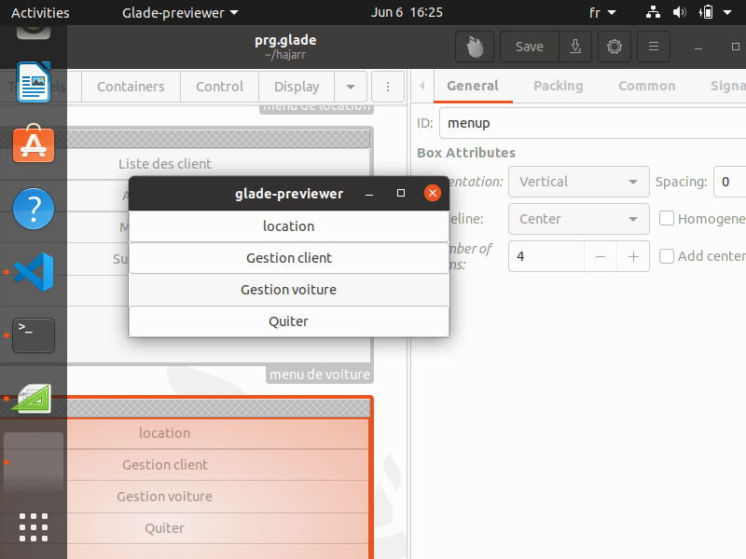
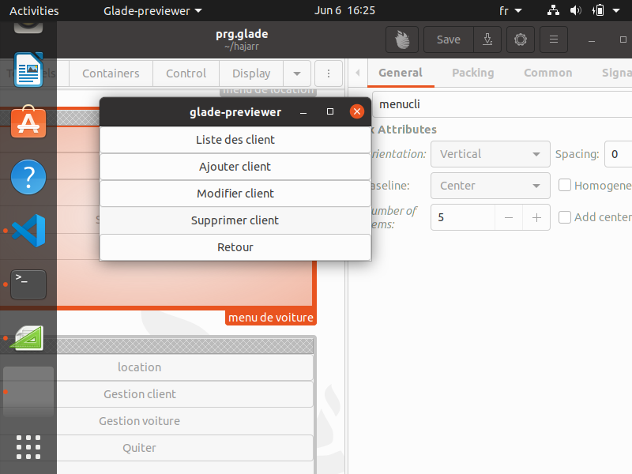
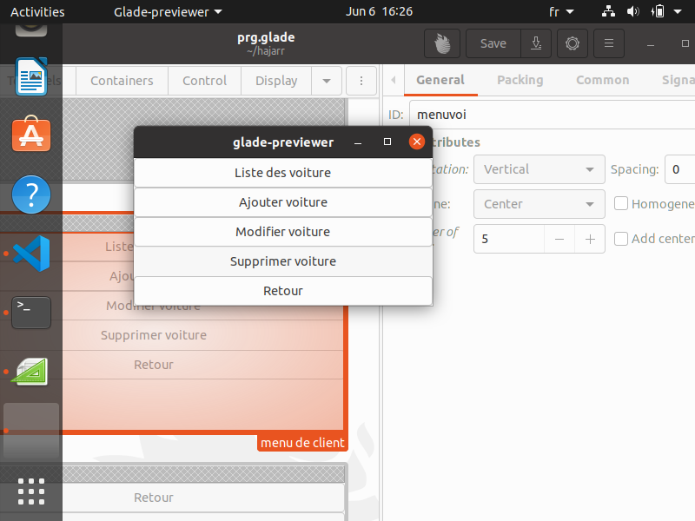
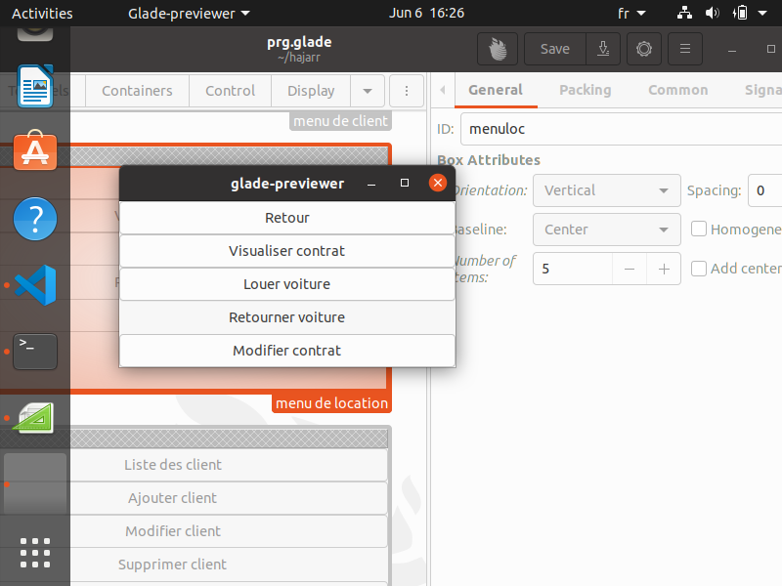
General view of my program with the graphocal interface
The PRINCIPALE Menu :
It’s the first window that shows up after
Execute my program
The Customer Management Menu:
it allows you to make five choices
Car Management Menu:
it allows you to make five choices
Car rental Menu
it allows you to make five choices

Slide 3
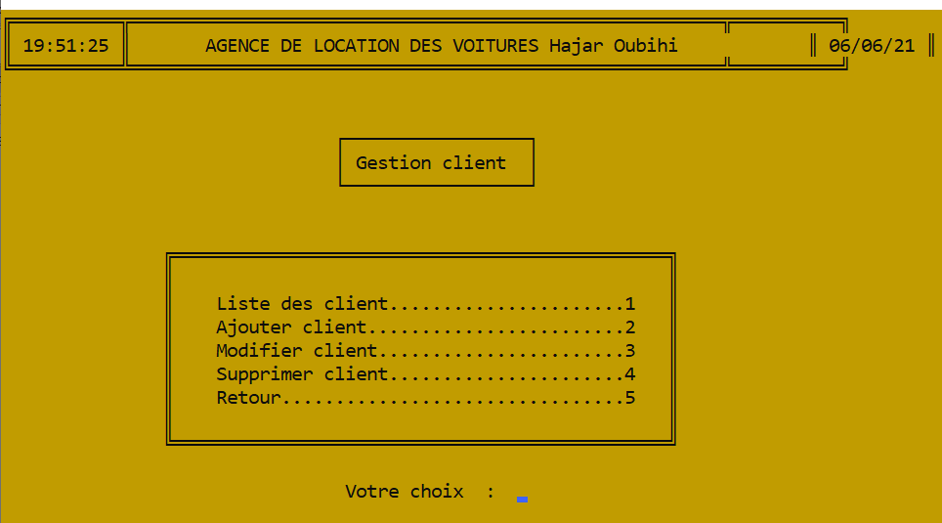
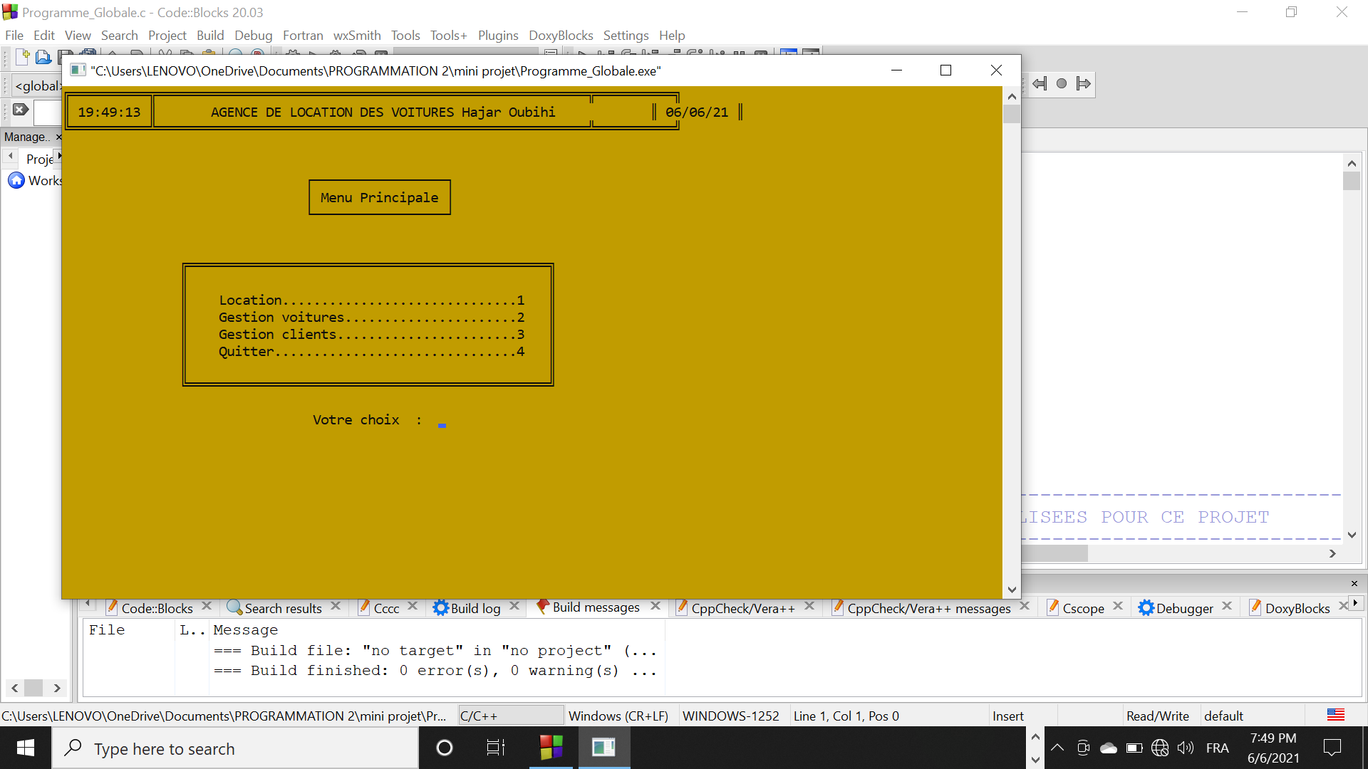
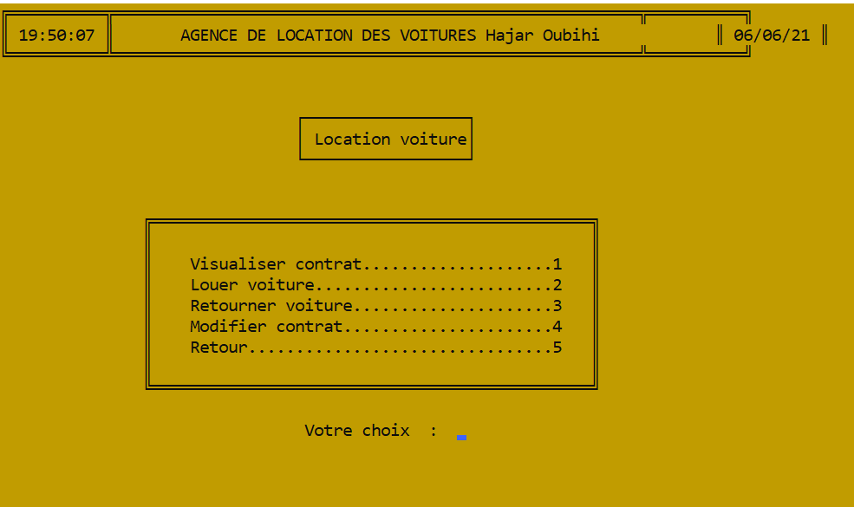
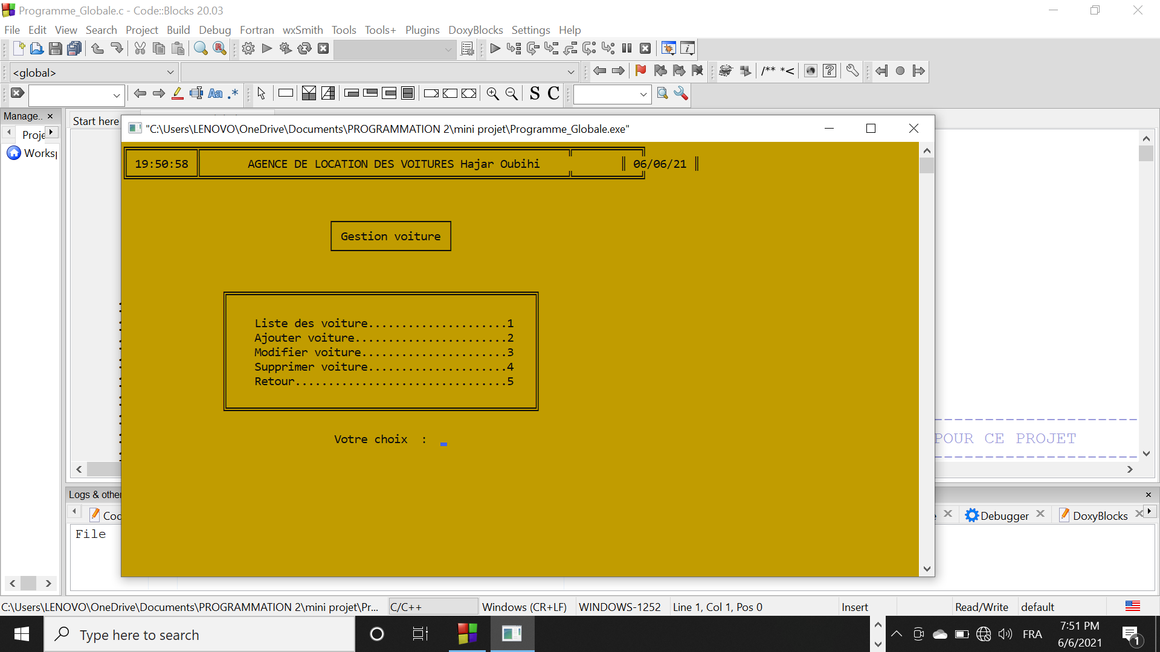
General view with the console

Slide 4
LES PROTOTYPES DES FONCTIONSET ET SOUS FONCTIONS UTILISEES POUR CE PROJET
void listeDesVoitures(char*);
void ajouterVoiture(char*);
void modifierVoiture(char *n,int);
void supprimerVoiture(char *,int);
void MenuGestionVoiture();
void listeDesClients(char*);
void ajouterClient(char*);
void modifierClient(char *,int);
void supprimerClient(char *,int);
void MenuGestionClient();
void visualiserContrat(char *,float);
int verifierClient(char *,int);
void voitureDisponile(char *);
void enLocation(char *,int,char *);
void louerVoiture(char *);
void retournerVoiture(char *,float);
void modifierContrat(char *,float);
void Retour();
void MenuLocation();
void Quitter();

Slide 5
CONCLUSTION
What Works:
C code works easly after a deep understanding of the course ,exept that was long .
First steps in the GTK+ was fun and easy to realise with glade ( about the Prancipale Menu) .
Glade is a RAD tool to enable quick & easy development of user interfaces for the GTK toolkit and the GNOM desktop environment,the user interfaces designed in Glade are saved as XML, and by usingthe GtkBuilder GTK object these can be loaded by applications dynamically as needed.

Slide 6
CONCLUTION
What doesn’t work: (well here is the biggest part XD)
It becomes too complicated to manipulate or even read the final code that contains the gtk libraries and ofcourse gtk functions even if i used glade that minimize my code a lot as i mentioned before(with using a file with extention .glade)
As i mentioned the code c was too long which was hard to improve its quality in order to make it as professional as possible
The BIG issue was that i cant manage my application i mean when a current window is here and i want to show an other one i have to destroy the last one and show the new one but if i want to realise the action of « quiter » i have to show up again the window that i destroyed before whitch was hard and in the last moment i discoverd new function in gtk that maybe gonna be easier because instead of use alot of windows we use one that Sets the text within the GtkLabels widget,and It overwrites any text that was there before.

Slide 7
Last things last
first of all about C code was a real practice of what we studied in both of “programmation” and “structure de donnees” and was also fun
The documentation of gtk was really useful but it's disappointing that it really contains a lot of functions and primitives that are really useful but i didn't discover it yet but for sure i'll do.

Slide 8
THANK YOU
Pour être honnête au début, il était difficile et
insupportable d'utiliser gtk parce qu
e cela semble vraiment être un haut niveau
de programmation, comme je ne peux
même pas imaginer que je puisse le comprendre
mais maintenant je suis fier de moi
que j'ai au moins comprendre comment cela
fonctionne et à cause de vous professeur
je suis vraiment reconnaissant à ce sujet
merci professeur

